Slide 1


BEHIND EVERY
RECORD,
A LIFE IS LOST!
Presented by : Fatima Ammar

Slide 2
BEHIND EVERY
RECORD,
A LIFE IS LOST!
Presented by : Fatima Ammar

Slide 3

INTRODUCTION
Data Collection:
Based on official crime reports from U.S. Government sources cases over the past 35 years from 1980 - 2014, including the FBI and other law enforcement agencies.

Slide 4
Problem Statement
Homicide cases involve many different factors like who the victim is, who the offender is, what weapon was used, and where it happened. By looking at these patterns, we can better understand how and why these crimes happen across the U.S.

Slide 5




AIMS:
Identify where and when homicides are most common across the U.S.
Understand the relationships between victims and offenders, especially gender & closeness affect outcomes.
Analyze who is most affected by homicides based on age, gender, and race.
Explore how weapons are used in different contexts and locations.

Slide 6





DATA OVERVIEW
638,454K
Total Homicide
1980 - 2014
Total Homicide
62.6%
Male Perpetrators
7.61%
Female Perpetrators
29.8%
Unknown Perpetrators

Slide 7
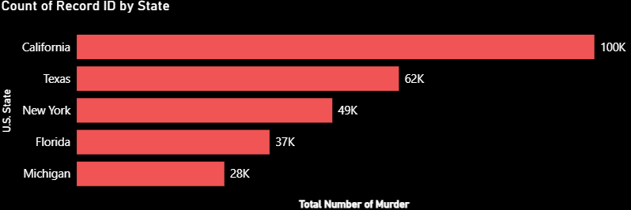
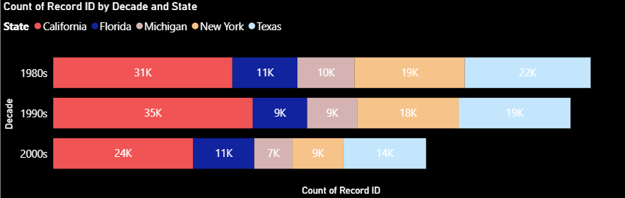

STATES WITH THE HIGHEST HOMICIDE RATES

Slide 8
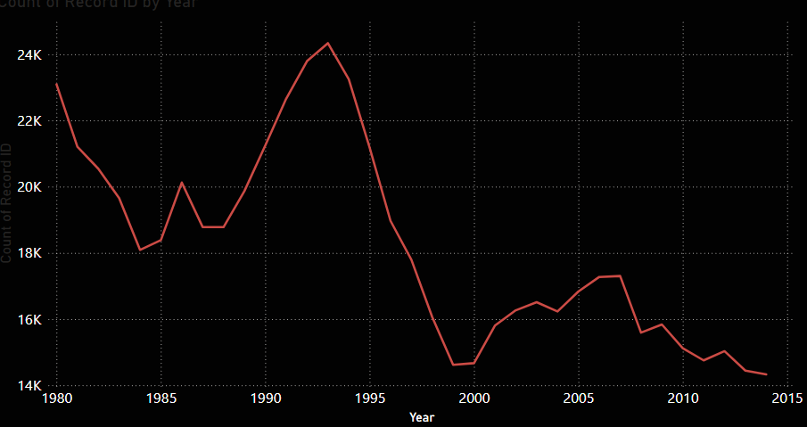

MURDER NUMBERS OVER TIME

Slide 9
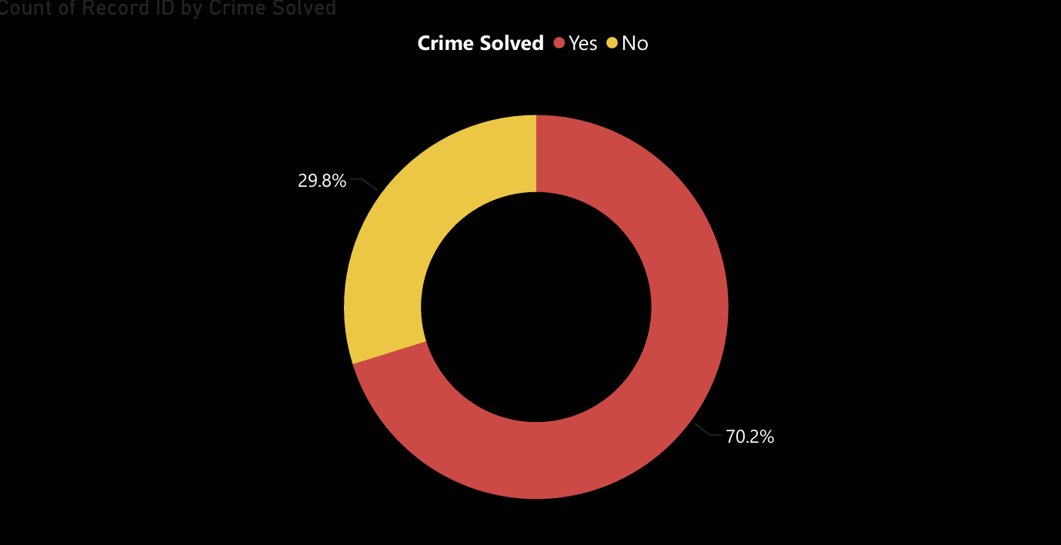

SOLVED VS. UNSOLVED HOMICIDE CASES

Slide 10
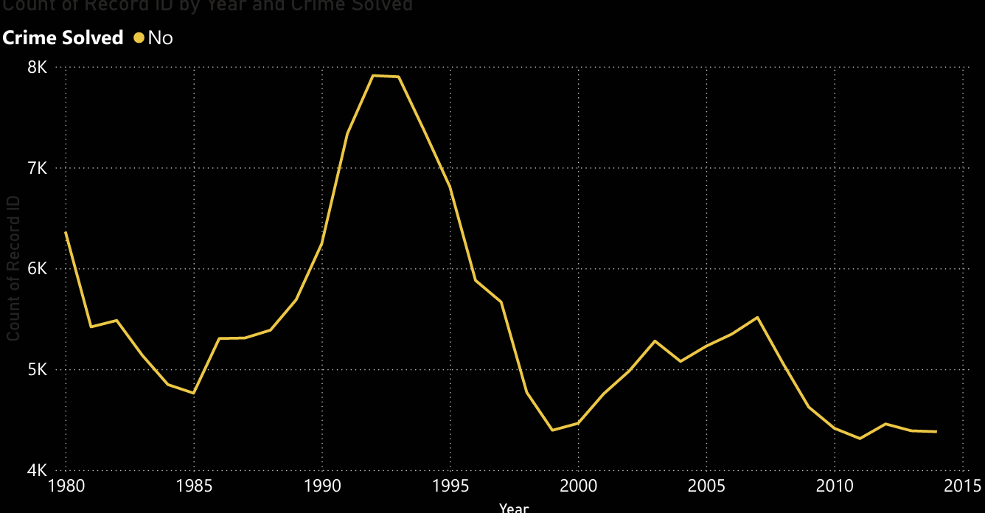

UNSOLVED HOMICIDES BY YEAR

Slide 11
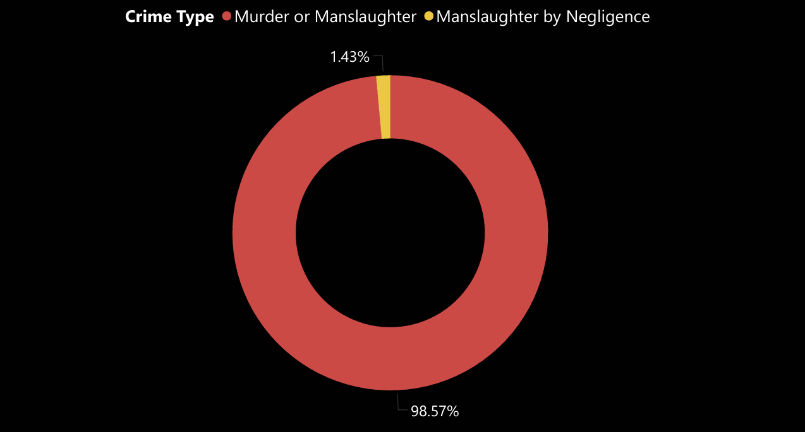

MURDER TYPE DISTRIBUTION

Slide 12
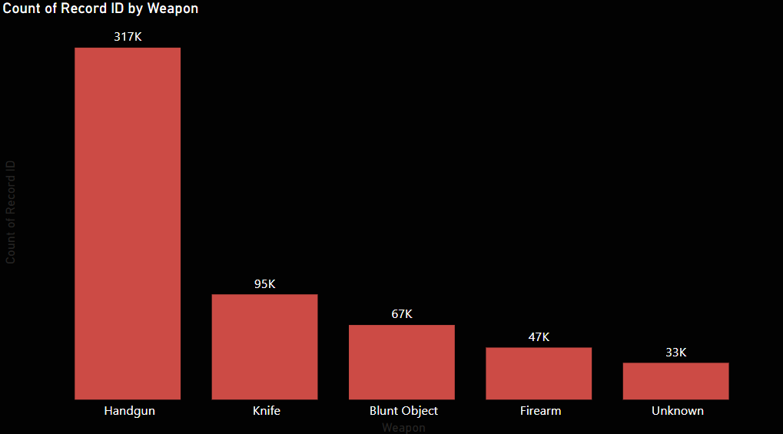

TOP 5 MURDER WEAPONS IN THE U.S
Total count of record id
Total count of record id
weapon

Slide 13
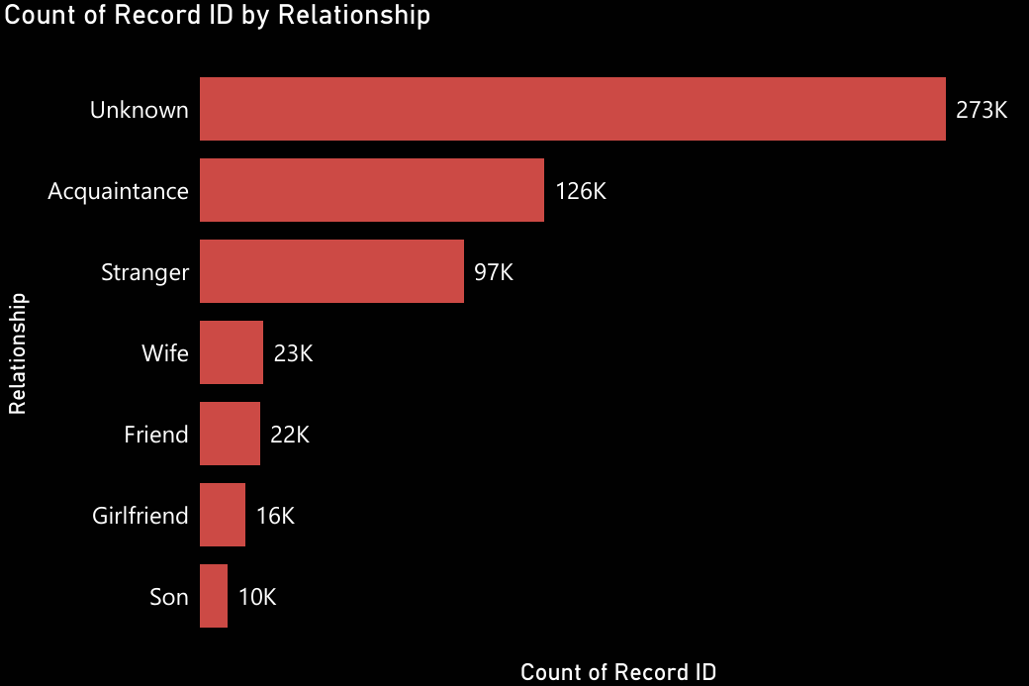

KILLED BY STRANGERS... OR SOMEONE CLOSER?

Slide 14
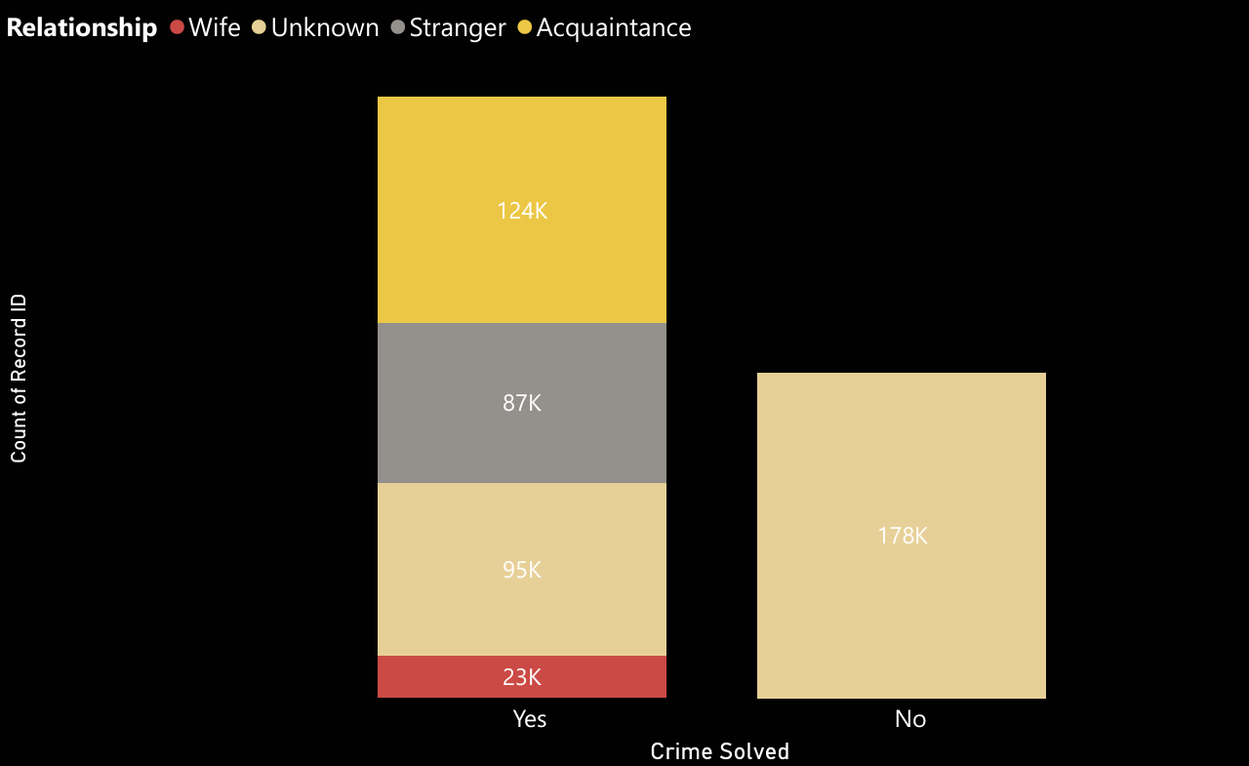

WHO DID IT? AND WAS IT SOLVED?
Total count of record id

Slide 15
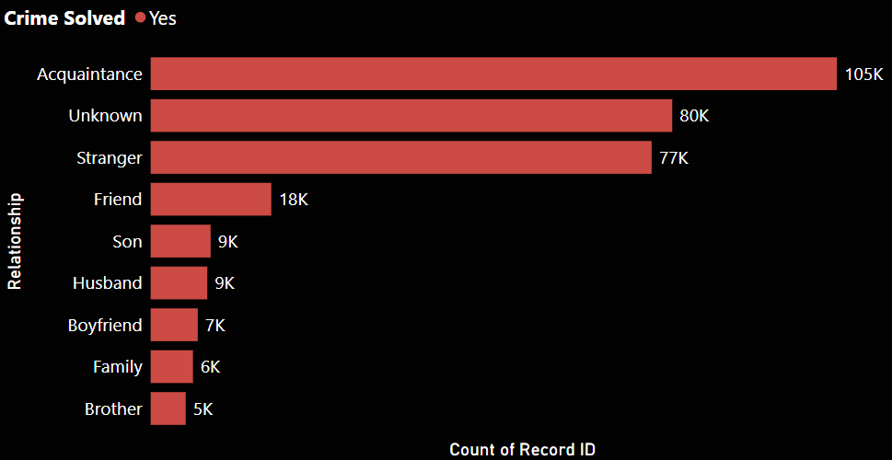
MURDERED MEN AND THEIR KILLERS

Slide 16
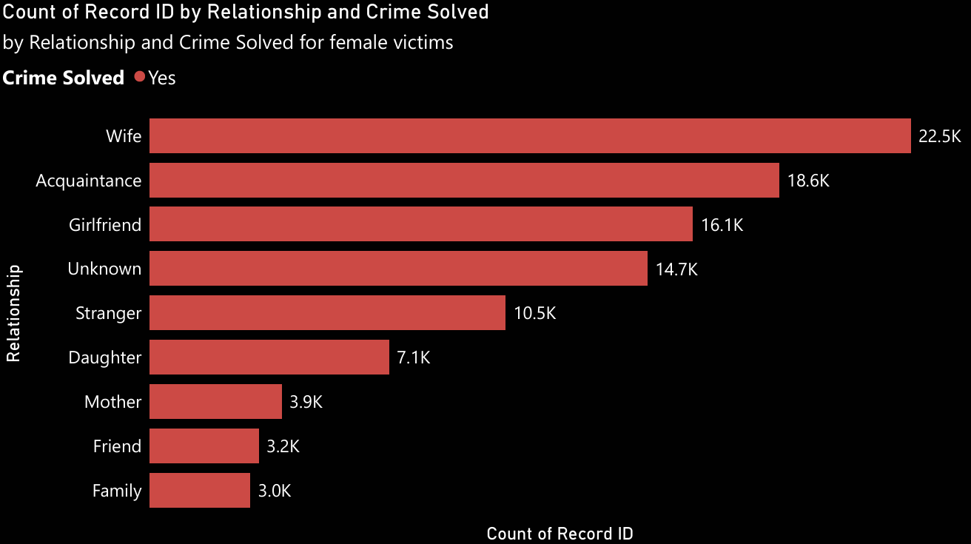

MURDERED WOMEN AND THEIR KILLERS
10869
Killed By Women
99381
Killed By Men

Slide 17
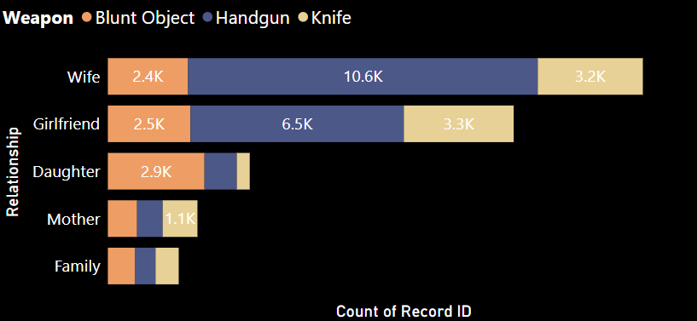

WHAT KILLS WOMEN IN CLOSE CIRCLES

Slide 18
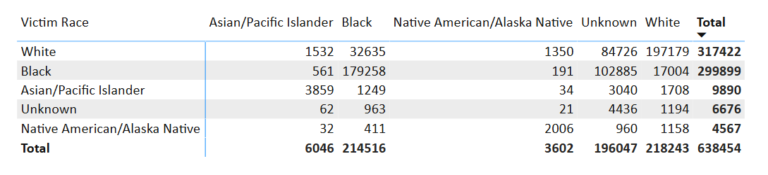
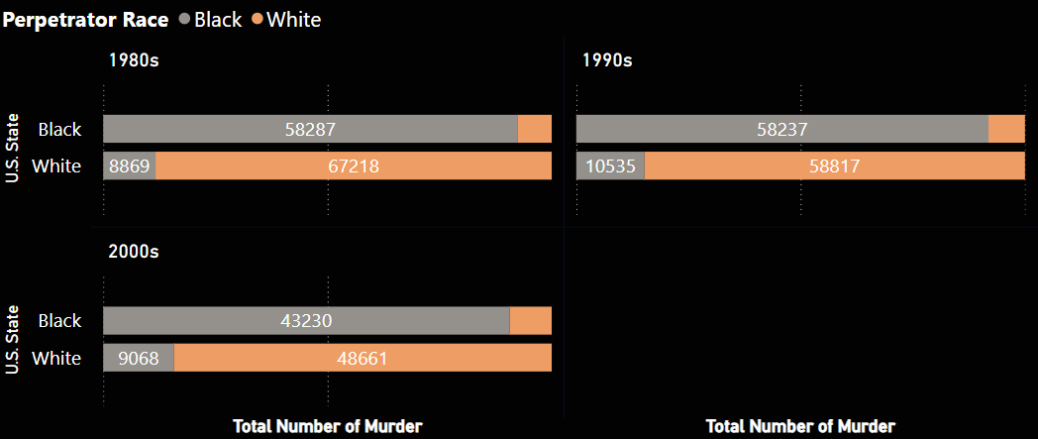

RACE BREAKDOWN: VICTIMS & OFFENDERS

Slide 19
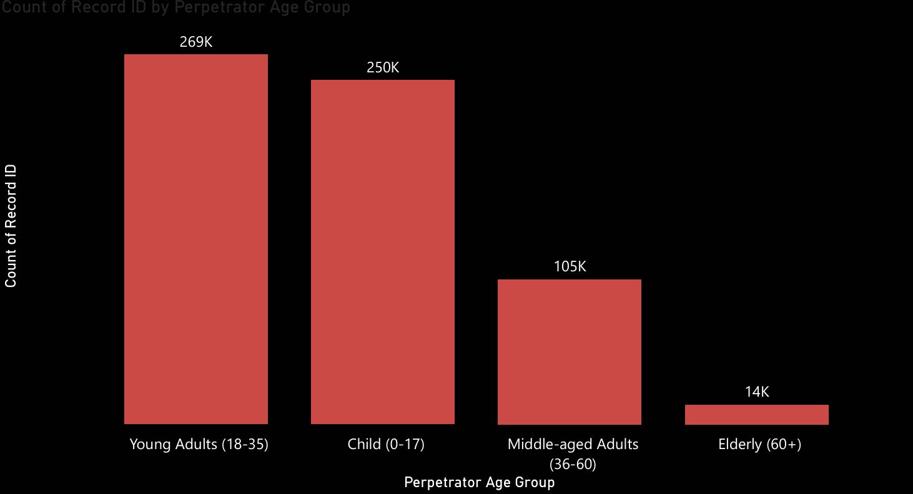

MOST MURDERED AGE GROUPS

Slide 20
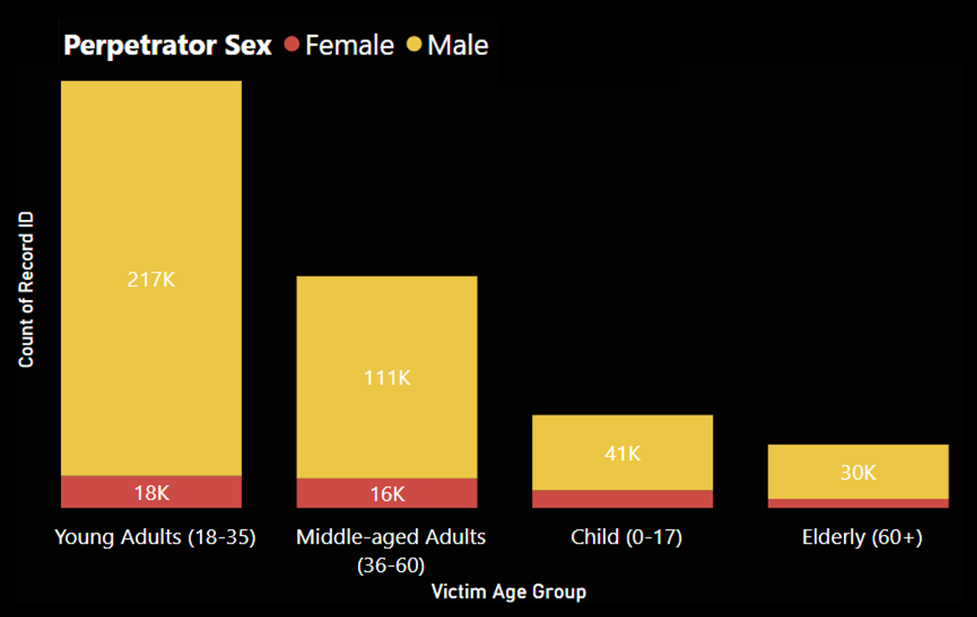

TOP OFFENDER AGE GROUPS

Slide 21



Summary:
Geographic Trends: Certain states like California and Texas consistently record high homicide rates.
Temporal Trends: Crime peaked between 1990–1995 before declining.
Solvability: A significant portion of homicides remains unsolved, especially where victim–offender relationships are unknown.
Weapon Use: Handguns dominate as the primary weapon in homicides.
Victim–Offender Relationship: Women are more likely to be killed by someone they know; men by strangers.
Demographics:
Young adults (18–35) are the most murdered group.
Most offenders are males aged 18–35.

Slide 22

Recommendations
Improve Data Collection Accuracy: Ensure all law enforcement agencies report consistent and complete data, especially in fields like perpetrator sex or weapon type.
Focus on Gun Control Policies: With handguns responsible for the majority of killings, reviewing gun accessibility laws could potentially reduce violent crimes.
Strengthen Domestic Violence Laws and Awareness: Relationship-based crimes )wife, girlfriend, e.g. ) highlight the need for stricter laws and expanded public awareness around domestic violence.
State-Level Policy Adjustments: States like California and Texas with high crime counts should analyze local causes and tailor strategies to their population dynamics.

Slide 24
THANK YOU!

